Slide 1
DATABASE MANAGEMENT SYSTEMS PROJECT
Laboratory Information
System
(LIS)
Health Information Systems | Database Management Systems Course
Presented by
Tronnie Amwesiga
Date: 06 / 05 / 2026

Slide 2
Introduction
What is a Laboratory Information System?
A Laboratory Information System is a database-driven platform that manages the complete workflow of a clinical or diagnostic laboratory — from physician test requests through sample collection, analysis, result validation, and final report delivery.
01
Patient Data
02
Test Orders
03
Samples
04
Results & Reports
Demographics, national ID, blood group, contact information
Physician requests, accession numbers, clinical notes, priority status
Specimen tracking from collection through processing and analysis
Result entry, validation, auto-flagging, formatted report delivery
Purpose:
To improve efficiency and accuracy in laboratory operations — automating order management, specimen tracking, result validation, and report generation.

Slide 3
Problem Statement
Challenges with manual, file-based laboratory systems
01
Data Loss
Solution
Paper records are vulnerable to physical damage, misfiling, and permanent loss during emergencies.
A computerised LIS database system that automates all laboratory workflows:
02
Slow Processing
Manual turnaround time is 4–6 hours vs. 1–2 hours with an automated LIS — delaying clinical decisions.
✓ Electronic test ordering
✓ Barcoded specimen tracking
03
Recording Errors
✓ Automated result entry & flagging
Manual transcription of results introduces clerical errors, with estimated error rates of 60–80% higher than digital systems.
✓ Digital report generation
04
Poor Tracking
✓ Role-based access control
No reliable way to track sample status, pending results, or abnormal findings in real time.
✓ Manager dashboards & analytics

Slide 4
Objectives
What the LIS database system is designed to achieve
1
Store Patient Information
2
Track Samples
Capture and securely store complete patient demographics — name, date of birth, gender, national ID, blood group, contact and address details.
Assign unique barcoded accession numbers to each specimen and track status from collection through receipt, processing, and analysis.
3
Record and Retrieve Results
4
Improve Accuracy
Allow laboratory scientists to enter test results, auto-flag abnormal values against reference ranges, and retrieve results instantly by patient, order, or date.
Eliminate manual transcription errors through digital data entry, automated validation, and strict role-based access — reducing clerical errors by an estimated 60–80%.
5
Generate Reports
6
Support Decision Making
Compile finalized results into formatted clinical reports delivered by print, email, or portal — replacing phone-based result communication.
Provide managers with workload statistics, TAT analysis, and abnormal result dashboards to support quality management and ISO 15189 compliance.

Slide 5
System Overview
End-to-end laboratory workflow managed by the LIS
1
2
3
4
5
Patient
Registration
Test Order
Entry
Sample
Collection
Lab
Processing
Result
Entry
Search or register patient; capture demographics & national ID
Doctor selects test(s), sets priority, adds clinical notes
Nurse collects specimen; LIS generates barcoded accession number
Sample received, condition verified, assigned to department queue
Scientist enters result; system auto-flags vs reference range
6
Result Validation
7
Report Generation
Scientist reviews and approves flagged/abnormal results; or sends for repeat testing
System compiles all results for an order; formats report; delivers by print, email, or portal

Slide 6
Key Entities
11 database tables — core entities of the LIS relational schema
PATIENT
patient_name, DOB, gender, phone, address, national_id, blood_group
DOCTOR
doctor_name, phone, department_id (FK)
patient_id (PK)
doctor_id (PK)
DEPARTMENT
department_name, description, head_tech_id (FK)
LAB_TECH
tech_name, role (Scientist/Technician/Manager), department_id (FK)
department_id (PK)
tech_id (PK)
TEST
test_name, sample_type, cost (UGX), department_id (FK)
TEST_ORDER
patient_id, doctor_id, order_date, status, clinical_notes
test_id (PK)
order_id (PK)
ORDER_TEST_ITEM
Bridge table — resolves M:N between TEST_ORDER and TEST
SAMPLE
accession_number, order_id, sample_type, collection_datetime, collected_by, condition, received_datetime
(order_id, test_id) PK
sample_id (PK)
RESULT
sample_id, test_id, result_value, flag (Normal/High/Low/Critical), result_datetime, validated_by, comments
REPORT
order_id, generated_by, generated_datetime, delivery_method, status (Draft/Final/Amended)
result_id (PK)
report_id (PK)

Slide 7
Entity Relationships
Multiplicities and relationship types across all 14 relationships
Entity A
Verb
Entity B
Type
Multiplicity
PATIENT
places
TEST_ORDER
Binary 1:N
One patient → many orders
DOCTOR
authorises
TEST_ORDER
Binary 1:N
One doctor → many orders
TEST_ORDER
produces
SAMPLE
Binary 1:N
One order → many samples
TEST_ORDER
includes
TEST
M:N
Via ORDER_TEST_ITEM bridge
SAMPLE
yields
RESULT
Binary 1:N
One sample → many results
TEST
defines
RESULT
Binary 1:N
One test → many results
LAB_TECH
collects
SAMPLE
Binary 1:N
One tech → many samples
LAB_TECH
validates
RESULT
Binary 1:N
One tech → many results
DEPARTMENT
classifies
TEST
Binary 1:N
One dept → many tests
DEPARTMENT
employs
LAB_TECH
Binary 1:N
One dept → many staff
TEST_ORDER
results in
REPORT
Binary 1:1
One order → one report
LAB_TECH
generates
REPORT
Binary 1:N
One tech → many reports
PATIENT+DOCTOR+TEST
constitutes
TEST_ORDER
Ternary
Many:Many:Many via TEST_ORDER
DEPARTMENT
supervises (head)
DEPARTMENT
Unary/Recursive
1:Many (one head, many staff)

Slide 8
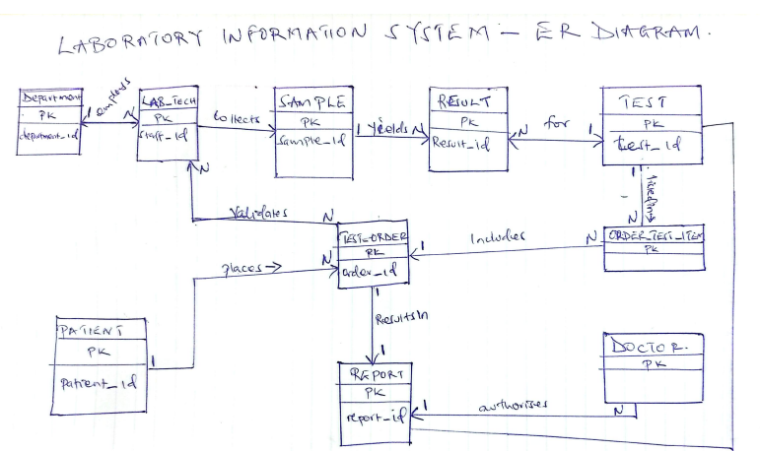
ER Diagram
Laboratory Information System — Entity Relationship Diagram

Slide 9
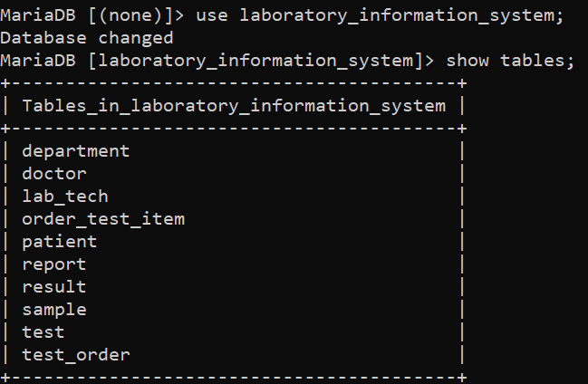
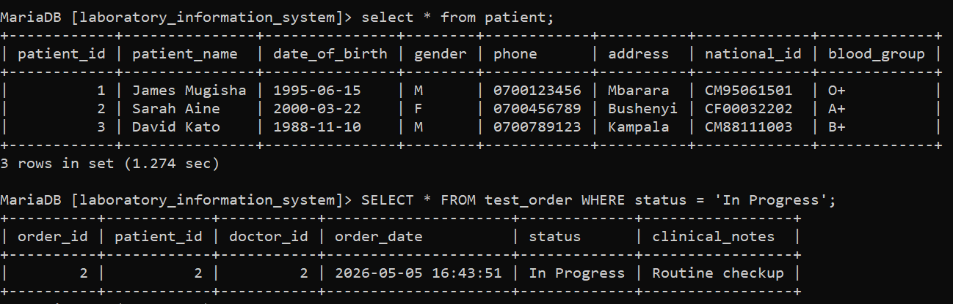
System Demonstration
Live MySQL implementation — database tables and sample data
SHOW TABLES
SELECT QUERIES
10 Tables Created
Sample Data Loaded
Queries Running
department, doctor, lab_tech, order_test_item, patient, report, result, sample, test, test_order
Ugandan patient names (James Mugisha, Sarah Aine, David Kato) with realistic demographics
SELECT * FROM patient; SELECT orders WHERE status = 'In Progress' — all returning correct results

Slide 10
Conclusion
✓
Improves Lab Efficiency
Reduces average turnaround time from 4–6 hours to 1–2 hours through automated order management and specimen tracking.
✓
Reduces Errors
Eliminates manual transcription, cutting clerical result errors by an estimated 60–80% and improving patient safety.
✓
Structured Relational Design
11 entities with 14 clearly defined relationships, implemented in MySQL with proper PKs, FKs, and bridge tables.
✓
Easy to Use and Manage
Role-based access for Scientists, Technicians, Managers, and Admins with intuitive workflow screens per user group.
Future Improvements:
Patient portal for online result access | AI-based critical-value alerting | Multi-site networked deployment | Billing module integration

